Slide 1
Zillow’s House Value Prediction
Praneeth Kandula Seetha Ram
Suganth Kumar Anil Kumar

Slide 2
Overview
1
Data Dictionary
2
Data Cleaning
3
Data Pre-processing
4
Exploratory Data Analysis
5
Build Models
6
Parameter Tuning and Cross Validation
7
Comparison of results
8
Challenges
9

Slide 3

Overview
Zillow is an online real estate database with data on homes across the United States.
One of Zillow’s most popular features is their property value prediction algorithm: the Zestimate. Zillow is constantly trying to improve its Zestimate. To help advance its accuracy even further, it launched a Kaggle competition.

Slide 4
Objective
The goal of the project is to predict the difference between the Zestimate and the actual sales price of homes. This may help Zillow identify where their algorithm falls short.
logerror =
log(Zestimate) – log(SalePrice)
Notes:
We take the log of the Zestimate and SalePrice so that we have a uniform scale because the actual error might range from a few thousand dollars to millions.

Slide 5
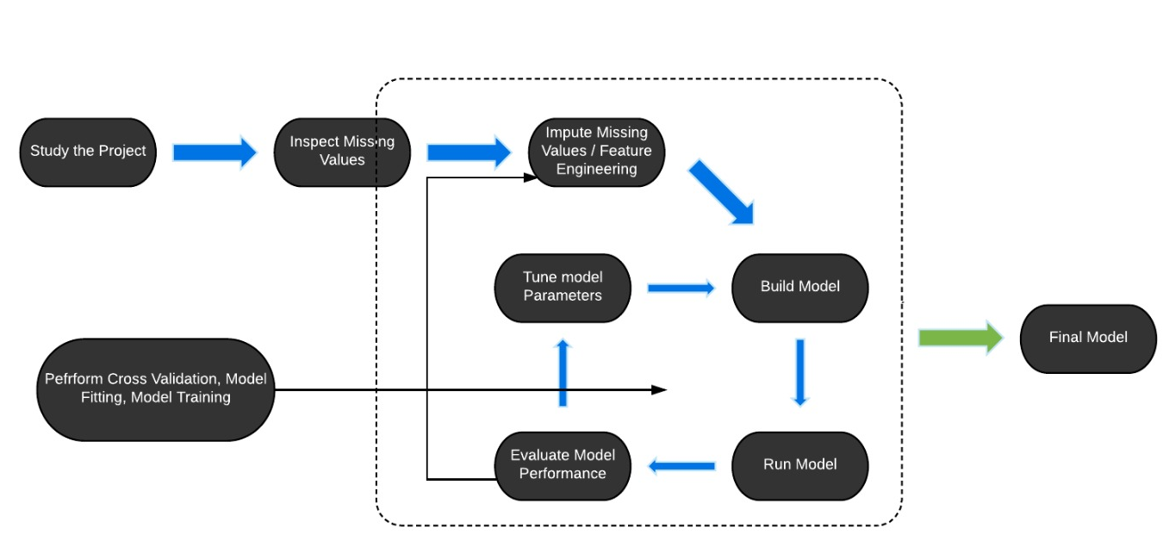
Workflow
Workflow
Notes:
Workflow followed for building our final model to predict the logerror values

Slide 6
Data
Important Variables
Total_finisharea
Total_bathcnt
Yearbuilt
Lotsizesquarefeet
Bedroomcnt
Totaltax
Latitude
Longitude
Buildingquality
Landusetypeid
The data consists of real estate data from three counties in and around Los Angeles, CA. Each observation has 56 features.
The training data has information for 77613 properties and a prediction set with only the feature information for 2,985,217 properties.
Click on the excel to view the entire Data Dictionary.
Notes:
We studied the data dictionary thoroughly to understand each variable, initially identified important variables based on our intuition.
Renamed the variables to make them easier to comprehend.

Slide 7
Missing Values
The data had a lot of missing values.
Analyzed and eliminated columns with more than 70% missing values.

Slide 8
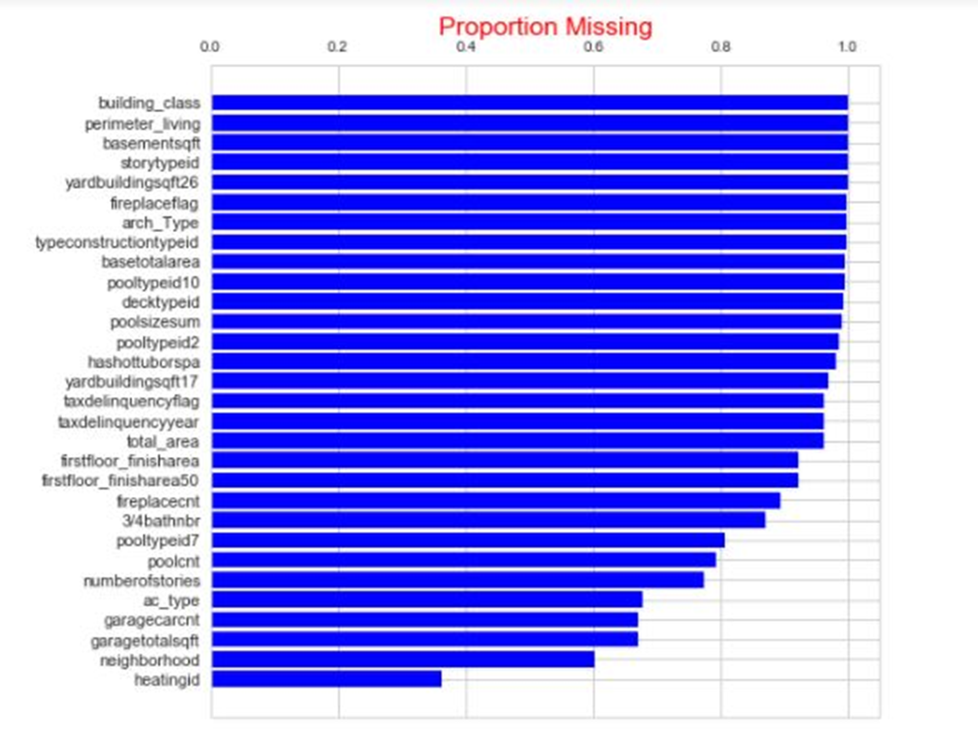
Proportion of Missing Values
Notes:
The above chart shows the percentage of missing values in each column. This is used to find columns with more number of missing values and remove them.

Slide 9
Exploratory Data Analysis
Comprehensive exploratory Data Analysis was performed to better understand trends and patterns in the data.
Used a combination of graphs and visualizations along with quantitative statistical analysis.

Slide 10
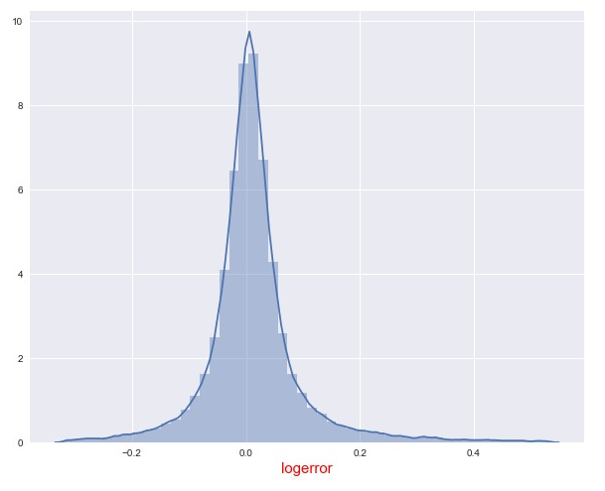
Normal Distribution of Target Variable logerror

Slide 11
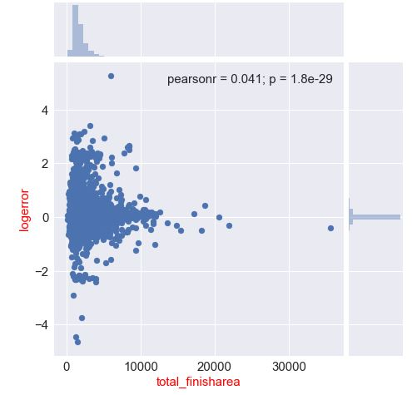
Variation of logerror with totalfinisharea
Notes:
* The logerror reduces as the total_finish area increases. Houses with lesser finished square feet has higher log errors.

Slide 12
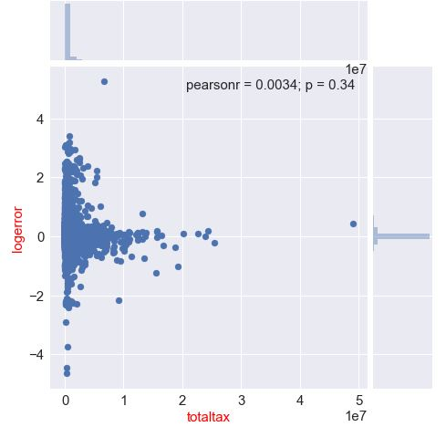
Variation of logerror with totaltax
Notes:
The logerror reduces as the totaltax increases.

Slide 13
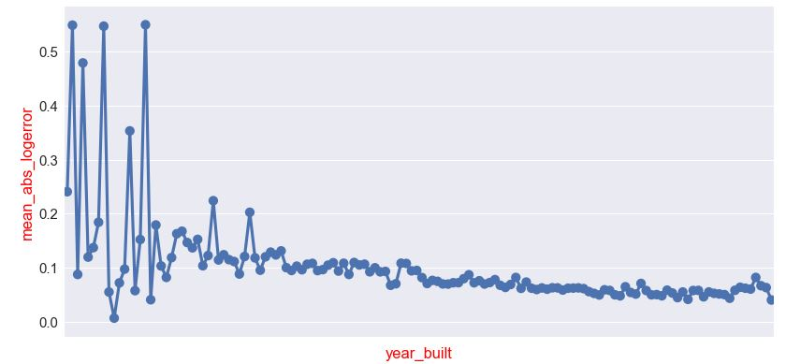
Variation of logerror with Year Built
Notes:
We could observe from above visualization newly built homes has less log error and old homes has high log error. When we had a closer look at the data we observed that new houses had lot of information whereas for old houses most of the information was missing. This could be a reason for higher log errors for old houses.

Slide 14
Imputing Missing Values
Numerical features were imputed using the mean.
Categorical features were imputed using the most frequent class.
Notes:
Strategies followed to impute missing values of features

Slide 15
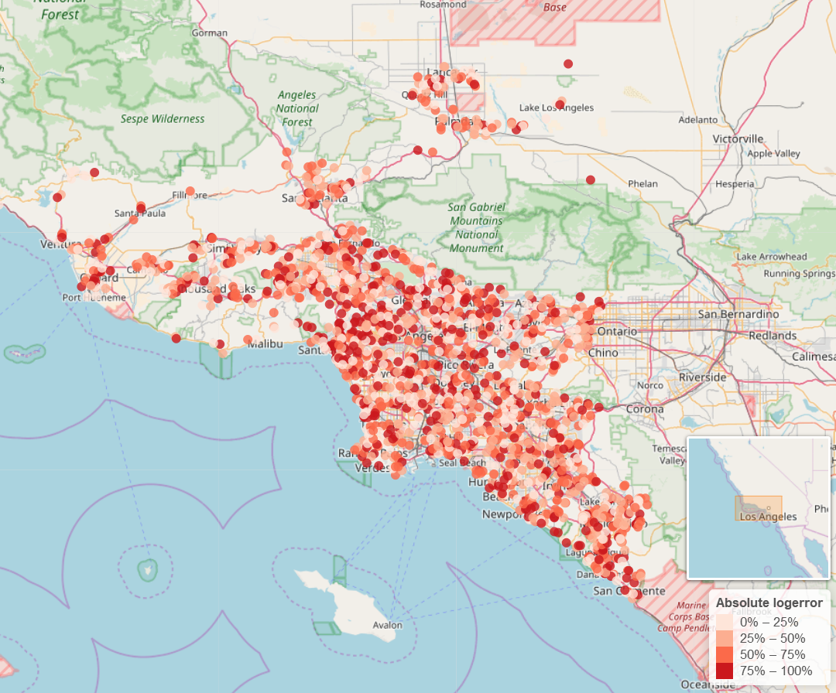
Visualizing the logerror on a map
Notes:
We plotted the property’s based on their latitude and longitude and we did not find any pattern with respect to logerror band.

Slide 16
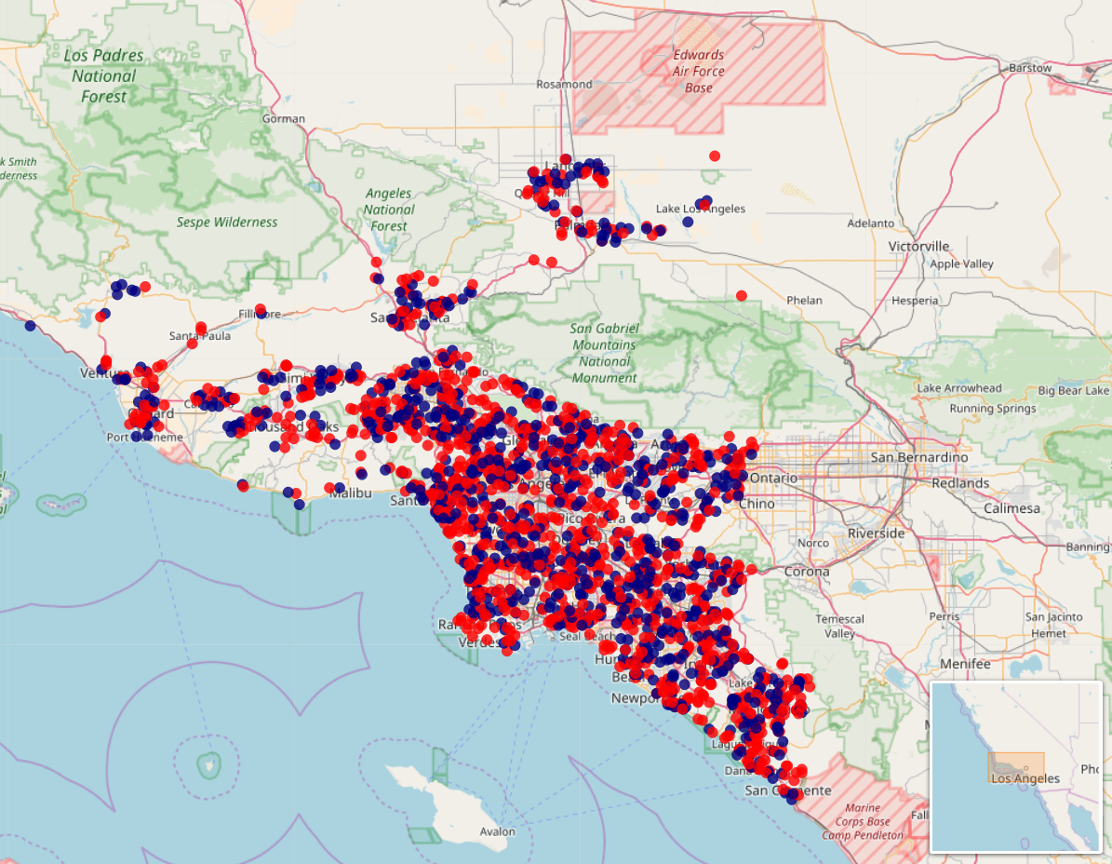
Overestimated and underestimated houses
Notes:
Overestimated and Underestimated property’s plot also confirms that error in prediction price of the algorithm is scattered and not specific to any particular county/region.

Slide 17
Feature Selection
Large No. of features present in the dataset.
Multiple methods used for feature selection.
Highly correlated features are eliminated.
Feature which were redundant were eliminated based on Variable importance using XGBoost.

Slide 18
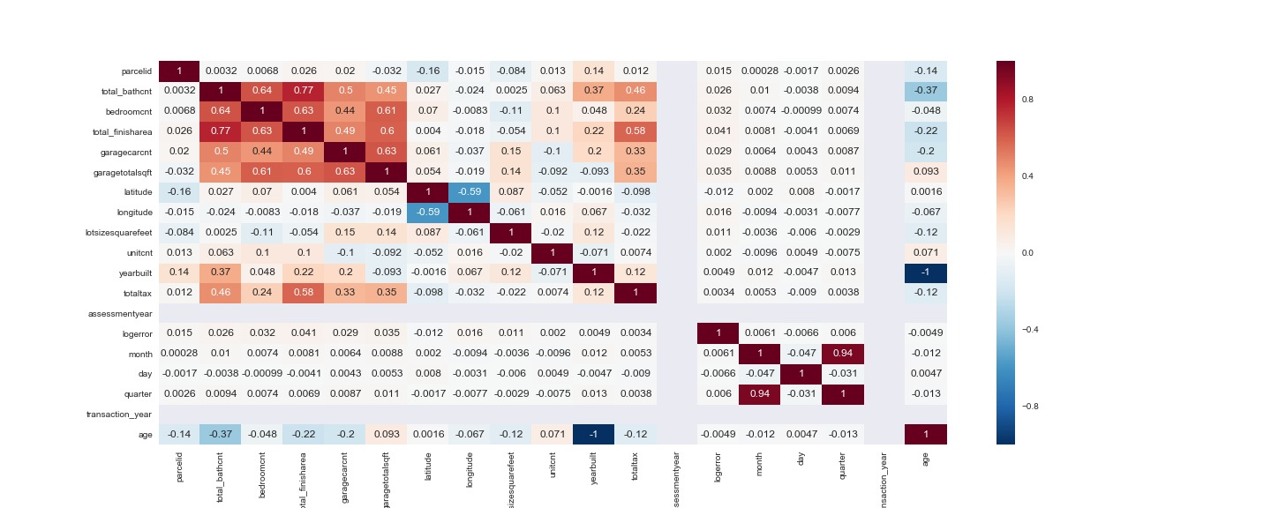
Correlation among feature variables

Slide 19
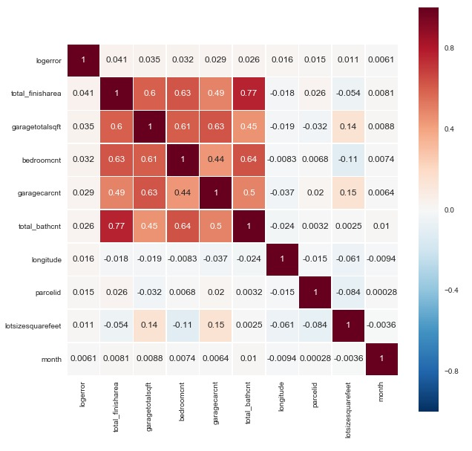
Strongly Correlated features
Notes:
With above visualization highly correlated features can be found and eliminated

Slide 20
Feature Engineering
New Features
Age of the House = Current Year – Year built
Total room cnt = bedroomcnt + totalbathcnt
Ratiototaxperyear = totaltax/taxperyear
Freespace = lotsizesquarefeet-total_finisharea

Slide 21
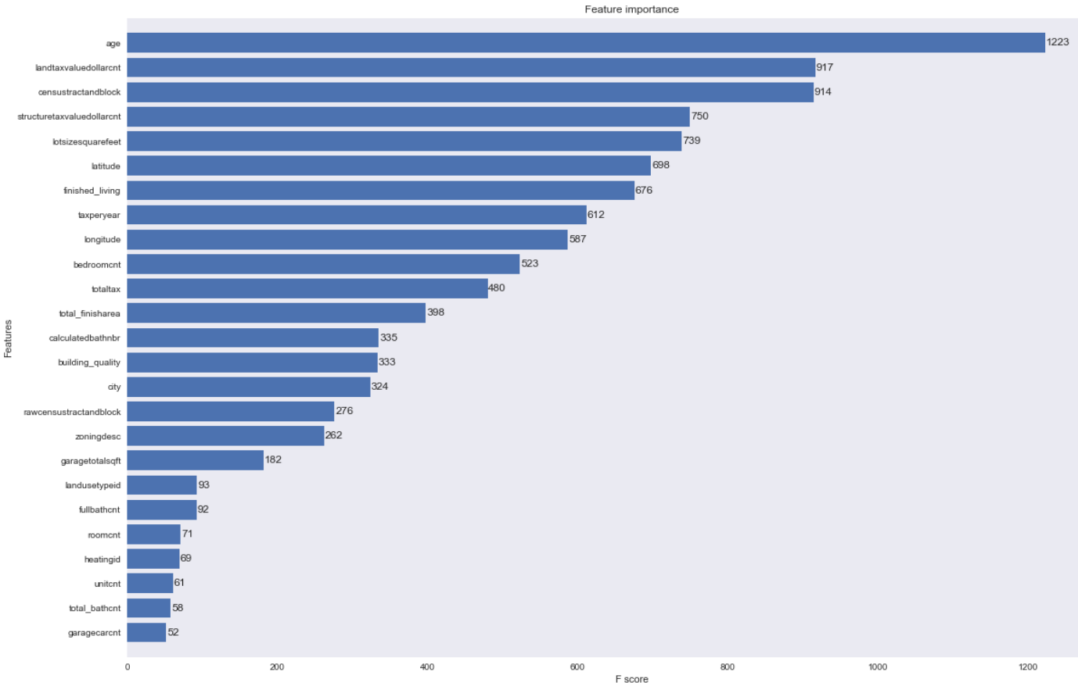
XgBoost for variable Importance

Slide 22
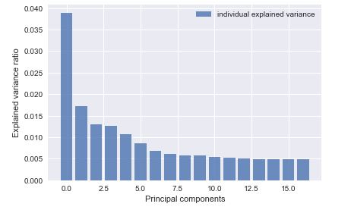
Principal Component Analysis
Notes:
Total of 40 variable have been reduced to 17 components which capture maximum of variance and from those 17, 7 variables are performed to build linear regression model

Slide 23
Models Comparison and Project code
Prediction Model | Mean Absolute Error
Linear Regression without PCA | 0.078
Random Forest | 0.086
Extreme Gradient Boosting | 0.07095
Principal Component Analysis (Linear regression) | 0.0710
Notes:
First three models were built using the default parameters and variables. Learning rate for linear regression was 0.01. learning rate for gbm was 0.3. depth of a tree 0.6. After that we did cv to find the most optimal parameters.
We used python for building our models. The project code file is attached in the ppt.

Slide 24
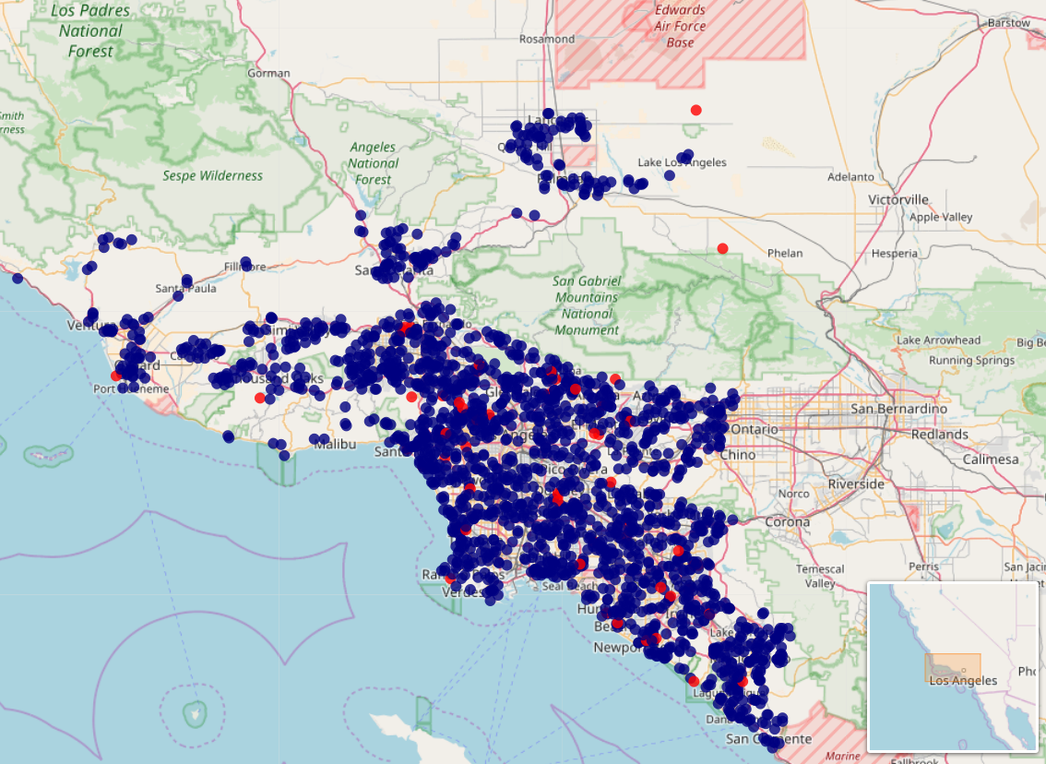
Houses with absolute logerror greater than 2 standard deviations away.
Notes:
If we assume that the error in the estimate is not due to Zillow’s algorithm but rather due to underestimation or overestimation of prices in the real world.
The houses with a large logerror would be of interest to potential real-estate investors.

Slide 25
Challenges
Missing Values
1
Feature Selection
2
Feature Engineering
3

Slide 26
Thank You

